Slide 1
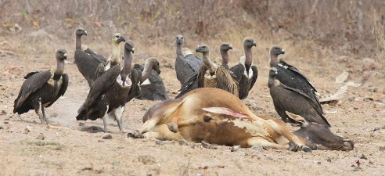
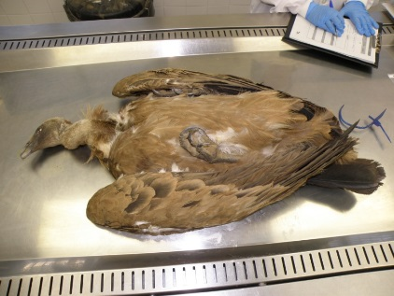
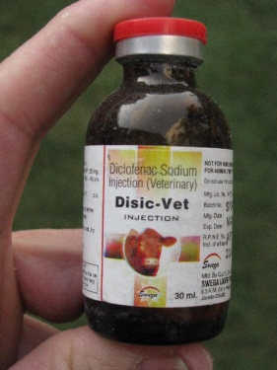
NSAIDs and the near-extinction of vulture populations across South Asia: An ecotoxicological “Perfect Storm”
Dr Mark Taggart, ERI, UK
In the late 1990’s, Old World vulture populations in South Asia began to collapse very rapidly. They fell from estimated levels in the 10’s of millions (of individuals), to near extinction, in just 15 years. The primary driver behind this was completely unexpected, when finally identified in 2004. The culprit, was a common veterinary pharmaceutical (an NSAID) called DICLOFENAC.
This talk will highlight the research that led to this discovery in 2004, and, the 15 years of work since that has helped us understand how and why this ecotoxicological “Perfect Storm” happened.
Dr Mark Taggart (Environmental Research Institute, UK) is an environmental analytical chemist and ecotoxicologist with ~28 years’ experience and 79 publications (in international journals and books). He has spent 23 years in academia, and 5 years in industry and environmental regulation. His interdisciplinary research interests focus on (i) the fate and behaviour of pollutants, especially classic and emerging contaminants (metals/metalloids and pharmaceuticals), (ii) ecotoxicology (pathways/uptake/effects, particularly with respect to birds and mammals) and (iii) analytical chemistry (new applications, method development and novel techniques). He has worked on the impact of NSAIDs on vultures since 2004, and sits on the Technical Advisory Committee for SAVE (‘Saving Asia’s Vultures from Extinction’) – an International research and conservation consortium.
Friday 28th June, 10:00

